Slide 1

+
AI-based Grievance Analyzer for Gram Panchayats

Slide 2

TY-B B.Tech – Artificial Intelligence & Data Science
Vidya Pratishthan’s Kamalnayan Bajaj Institute of Engineering & Technology, Baramati.
Shinde Rutuja Ajay [Roll No: 23107120] Rasal Aarya Vijay [Roll No: 23107101] Pawar Shreyash Nand [Roll No: 23107093] Jadhav Mayuresh Mahesh [Roll No: 23107076]

Slide 3

Introduction
Villages face issues (water, road ,electricity etc) but complaints are ignored.
Complaints are handwritten in local languages (Marathi/Hindi).
Automatic digitization, classification, and routing to the correct authority
Single dashboard for tracking, analytics, and accountability at
Panchayat level
Proposed: AI System to digitalize classify & route complaints.

Slide 4
Problem Statement
To develop a Smart Grievance Management System for Rural Governance – an AI-based solution that enables timely and transparent complaint resolution in Gram Panchayats.

Slide 5

Objectives
To develop a system for accepting grievances in both text and voice formats.
To ensure multilingual support (English and Marathi) for inclusivity.
To implement NLP techniques for automatic classification of complaints.
To apply sentiment analysis for determining urgency and seriousness.
To create a structured database for storing and managing grievances.
To design an interactive dashboard for Panchayat officers as well as citizens and with filter sand chart

Slide 6
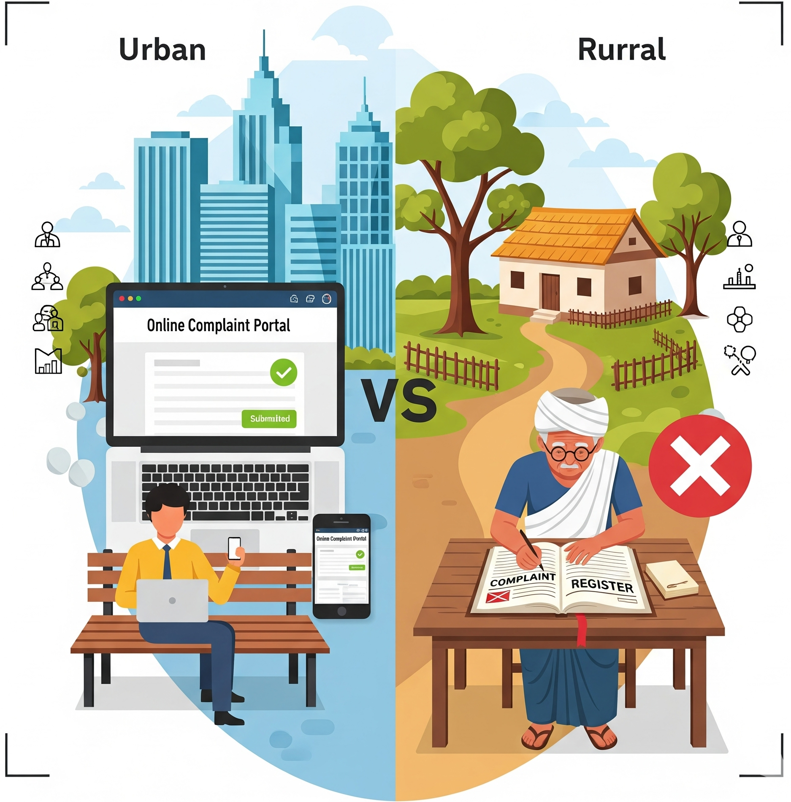
Motivation
Citizens struggle with submitting complaints due to multiple channels and manual processes.
Delays and lack of tracking reduce accountability and citizen satisfaction.
Rural areas face additional challenges like low connectivity and device limitations.
A unified, intelligent system is needed to simplify complaint submission and improve governance.

Slide 7
Architecture
🔹 Input Layer – Complaints via OCR (handwritten),
Speech-to-Text (voice), UI Text. 🔹 Processing Layer – NLP for classification, summarization,
and pin code extraction. 🔹 Storage Layer – Database/CSV logs for structured complaint records. 🔹 Output Layer – Dashboard for officials & Auto-forwarding to departments.

Slide 8
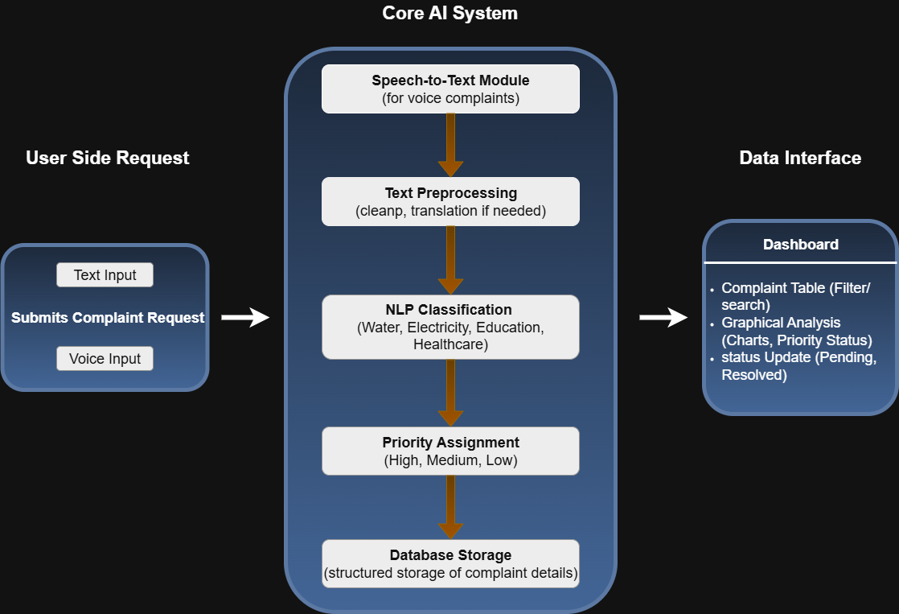

Slide 9
Methodology / Techniques Used
Speech-to-Text(ASR): multilingual, noise-robust.
OCR/ICR: binarization, skew correction, segmentation.
NLP: transformer models(topic, intent, urgency).
NER & Geocoding: extract addresses, pin codes, schemes.
Workflow Engine: SLA timers, escalation rules, audit trails.
Storage: CSV-first → DB-ready schema.

Slide 10
Technique | Tool/Library
OCR | Tesseract, EasyOCR
Speech-to-Text | Whisper, Google API, Vosk
NLP Preprocessing | NLTK, spaCy
Classification | Naive Bayes, Logistic Regression, Transformers
Summarization | TextRank, mT5
Storage & UI | CSV, MySQL, Flask/Stream lit

Slide 11
Expected Outcomes
Fully digitized complaint management system.
Automatic categorization and summarization of complaints.
Faster resolution via accurate department routing.
Forwarding mechanism to ensure complaints reach the correct authority.
Unique complaint ID’s with easily searchable records.
Panchayat dashboards for tracking and monitoring complaints.
Portable CSV datasets for audits and interoperability.

Slide 12
Applications
Citizen Service Desks & Mobile Intake Camps – Efficient complaint capture on site.
Panchayat Routing – Streamlined handling of roads, water, sanitation, and welfare issues.
District-Level Monitoring – Identify recurring problems and trends for better planning.
Integration with E-Governance Platforms – Seamless link with Digital India portals and mobile apps.

Slide 13
Limitations
Handwriting OCR: Regional scripts (Marathi, Hindi, etc.) may not be recognized with high accuracy.
Address Ambiguity: Pin codes/area names can overlap, causing routing errors.
Human-in-the-Loop Needed: Low-confidence OCR/NLP outputs require manual correction.
Connectivity Gaps: Rural areas may face sync issues → offline-first mechanism required.

Slide 14
Conclusion
The multimodal AI system digitizes voice, handwritten, and text complaints into structured records, enabling faster routing and transparent tracking. It supports regional languages for inclusivity and provides dashboards to identify recurring issues. Scalable to block, district, and state levels, it empowers citizens and Panchayats while laying the foundation for digital rural governance.

Slide 15
References
Hutto, C.J., & Gilbert, E. (2014). VADER: A Parsimonious Rule-based Model for Sentiment Analysis of Social Media Text. Proceedings of ICWSM
Jain, A., & Garg, A. (2021). AI-Based Grievance Redressal System for E-Governance. International Journal of Computer Applications, Vol. 183, No. 32.
Dash, A., Mohanty, S., & Sahoo, B. (2021). An Intelligent Public Grievance Redressal System Using Machine Learning Techniques. International Journal of Information Technology and Computer Science, 13(4), 35–42.
Jha, R., & Singh, R. (2021). AI-Driven Solutions for Grievance Redressal in Smart Villages. Proceedings of IEEE SmartTechCon.
Pedregosa, F., Varoquaux, G., Gramfort, A., et al. (2011). Scikit-learn: Machine Learning in Python. Journal of Machine Learning Research, 12, 2825–2830. (classic practical ML library reference for modelling/classification)

